Slide 1
Plant Diseases
Classification
Presented by
Tanzela Nasrin Aohana 180204012
Md. Tamzidul Islam 180104123
Md. Mubayeer Rahman 180104144
Muhammad Khaleduzzaman 180104102

Slide 2
Table of contents
Introduction
Background Study
Dataset
Methodology
01
02
03
Literature Review
04
05
06
Result Analysis
07
08
Conclusion
References

Slide 3
Introduction
The development of food crops is significantly impacted by the many plant diseases.
Plant diseases can be systematically divided into fungal, oomycete, hyphomycete, bacterial, and viral types.
Bangladesh is an agricultural country. In order to match the food demand, agricultural problems should be addressed by advanced techniques.
The agricultural industries are focusing on artificial intelligence methods.

Slide 4
Background Study
Convolution
ReLU
Max Pooling
Flattening
Full Connection
The most crucial component of CNN
Used for increasing the non-linearity
Used to determine the maximum value for a feature map
Rearranged feature map which is pooled into single column
The hidden layer is fully connected

Slide 5
Literature Review
Here’s what we’ve found researching different papers:
Emanuel Cortes used CNN and adversarial networks were used to classify plant diseases, with rs-net achieving 80% in 5 epochs.
Konstantinos P. Ferentinos and colleagues developed CNN models identify and diagnose crop diseases using 87,848 photos from an open collection, with a high success rate of 99.53%.
Mohanty and Sharada P proposed deep CNN model is designed to identify four prevalent disorders in sick apple leaves using a database of 13,689 images. It has a 97.6% overall accuracy and a faster convergence rate, improving disease control.

Slide 6
References
Here are some references which helped us doing this paper:
1. Cortes, Emanuel. ”Plant disease classification using convolutional networks and generative adversarial networks.” (2017).
2. Wallelign, Serawork, Mihai Polceanu, and Cedric Buche. ”Soybean plant disease identification using convolutional neural network.” The thirty-first international flairs conference. 2018.
3. Mohanty, Sharada P., David P. Hughes, and Marcel Salath´e. ”Using deep learning for image-based plant disease detection.” Frontiers in plantscience 7 (2016): 1419.
4. S Ramesh,D.Vydeki“Rice Blast Disease Detection and Classification Using Machine Learning Algorithm.”,2021.

Slide 7
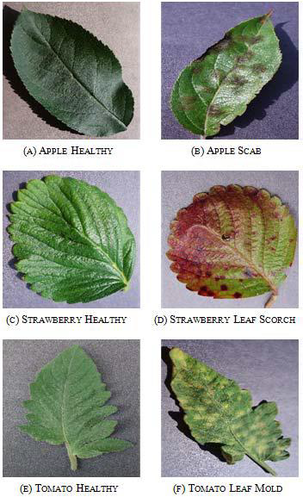
Datasets
The Plant Village dataset consists of 54303 healthy and unhealthy leaf images divided into 38 categories by species and disease.
The dataset used in our study was a picture of the leaves of potato plant and tomato plant, divided into 4 classes: healthy leaves, early blight, and late blight and mosaic. The amount of data used was 1000 for early blight,1000 for late blight, 373 for mosaic virus, and 1743 for healthy leaves.

Slide 8


Methodology
Gabor Filter
Sobel Filter
CNN Model
g_{λ,θ,ϕ,σ,γ} (x,y) = exp($−\frac{(x^{2}+γ^{2}y^{2})}{{2σ}^{2}}$) cos(2π$\frac{x}{λ}+φ$)
G = $\sqrt{G_{x}^{2}+G_{y}^{2}}$
training data size 0.85 and took test dataset size 0.3
Combines a Gaussian window and a short-term Fourier transformation for analysis in the spatial domain
The Sobel filter is a popular method to calculate partial derivatives
Employs multiple perceptions to evaluate picture inputs

Slide 9
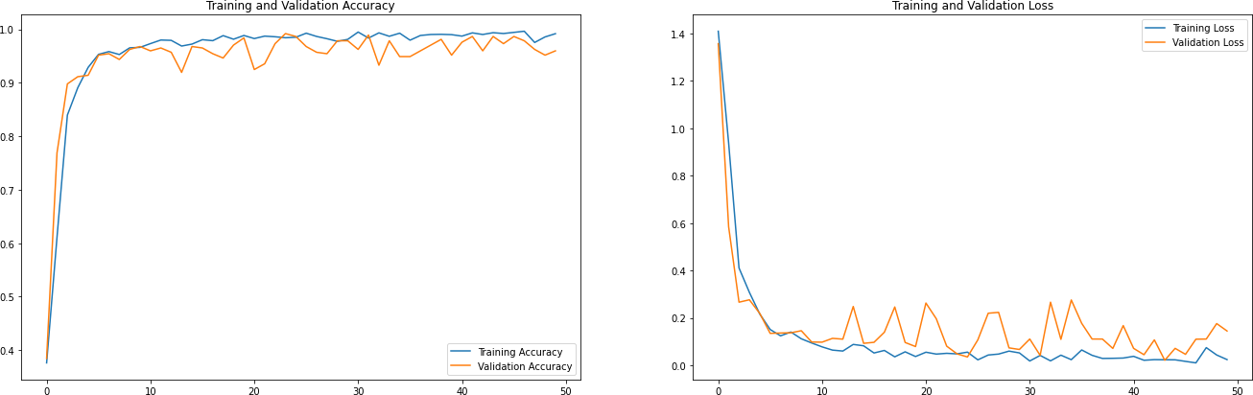
Result Analysis
The graph shown below is for CNN model (a) accuracy graph and (b) loss graph when the train: test is 85:15. The blue line is for training dataset and the orange line is for testing dataset.
(a)
(b)

Slide 10
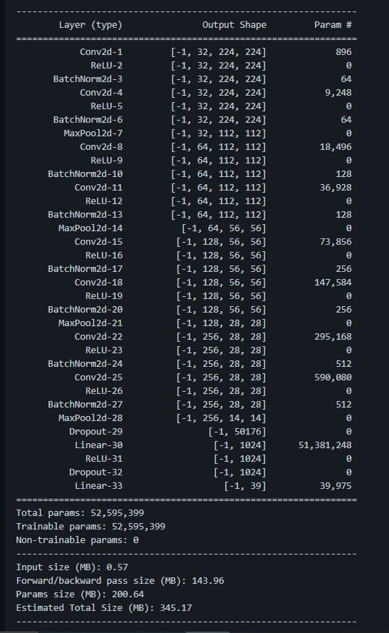
Result Analysis
Models | Test accuracy | Test Loss
CNN | 98.9% | 3.91%
Table: Test Accuracy and Loss for CNN model
Epoch | Data Training |  | Data Testing
 | Acc | Loss | Val ACC | Val Loss
40 | 0.9903 | 0.0273 | 0.9651 | 0.1164
41 | 0.9939 | 0.0202 | 0.9839 | 0.0845
42 | 0.9851 | 0.0421 | 0.9516 | 0.1907
48 | 0.9912 | 0.0264 | 0.9919 | 0.0504
49 | 0.9912 | 0.0238 | 0.9651 | 0.1767
50 | 0.9912 | 0.0263 | 0.9839 | 0.0698
Table: Result from fit model 85:15 (CNN)
Figure: Convolutional Neural Network Model

Slide 11
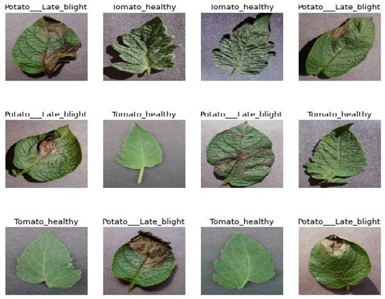
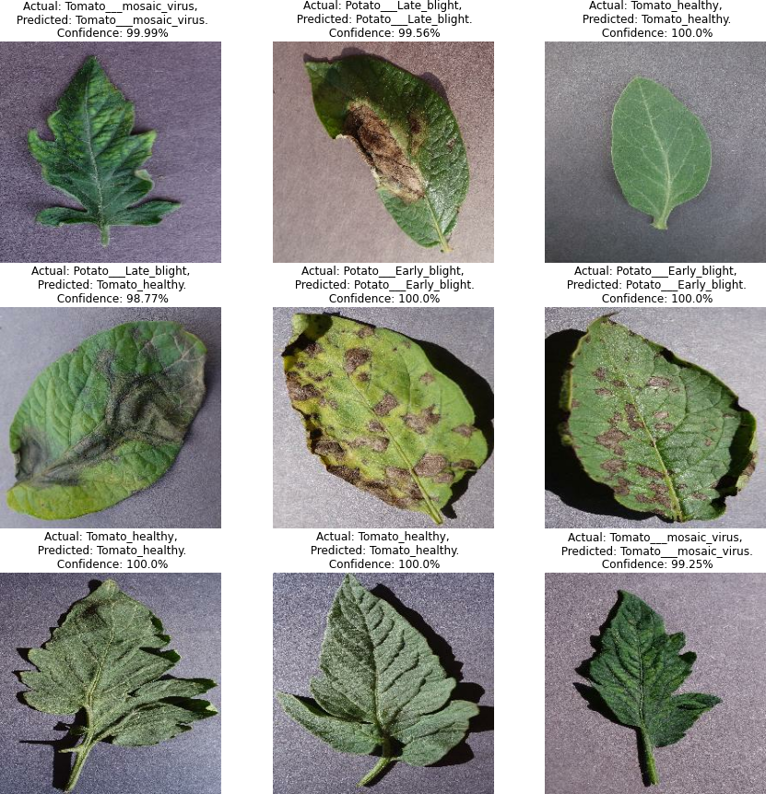
Result Analysis
Figure: Test input for CNN
Figure: Test output for CNN

Slide 12
Conclusion
The neural network is trained with Plant Village dataset.
Our convolutional neural network trained to identify and recognize plant leaf disease was able to correctly classify and predict diseases with 98.9% accuracy.

Slide 13
Thanks!
Do you have any questions?

